Slide 1
Lecture 9: Sampling Distribution
Jibo He, Ph.D.
Associate Professor
Wichita State University
jibo.he@Wichita.edu

Slide 2
Review of Probability
Sample space, event, random variable
Relationship between events
Mutually exclusive events
Exhaustive set of events
Independent events
Probability
# outcomes in some event__
# outcomes in sample space

Slide 3
Review of Probability
Sampling with and without replacement
Conditional probability and Bayes theorem
Probability rules
Probability is bounded by 0 and 1
Sample space has a probability of 1
Mutually exclusive events P(A or B) = P(A) + P(B) or general addition rule P(A or B) = P(A) + P(B) – P(A and B)
Multiplication Rule for Independent Events
P(A and B) = P(A)P(B)
P(A and B) = P(A) P(B | A)

Slide 4
Inferential Statistics
“Inferential statistics” tries to make inferences about the population of interest (population parameters) from sample data (sample statistics).
To do this, we need to figure out
Sampling error
Variability of a statistic from sample to sample due to chance
How to figure out the magnitude of sampling error?
Through sampling distributions
Notes:
The difference

Slide 5
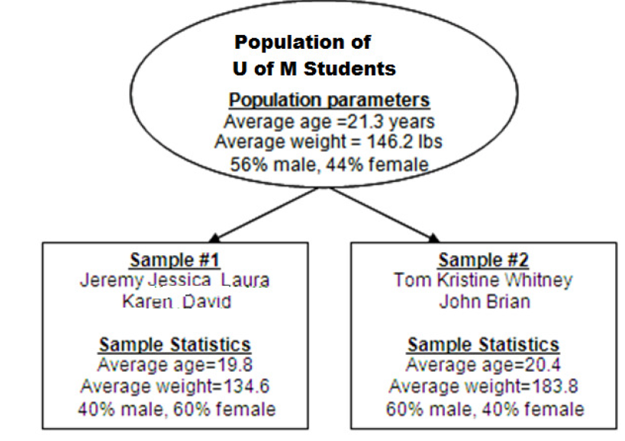
Sampling error
In statistics, sampling error or estimation error is the amount of inaccuracy in estimating some value that is caused by only a portion of a population (i.e. a sample) rather than the whole population.
Population of Wichita State University Students
Notes:
Or the difference between a sample statistic and a population parameter that is due to chance.

Slide 6
A motivating example
Ruback and Juieng (1997) ran a simple study in which they divided drivers into two groups of 100 participants each---those who had someone waiting for their space and those who did not. They then recorded the amount of time it took the driver to leave the parking space. For those who have no one waiting, it took an average of 32.15 seconds to leave the space. For those drivers who had someone waiting, it took an average of 39.03 seconds. For each of these groups, the standard deviation of waiting time was 14.6 seconds. Notice that a driver took 6.88 seconds longer to leave a space when someone was waiting for it.

Slide 7
A motivating example
It is entirely possible that having someone waiting does not make any difference in how long it takes to leave a space, and the difference is due to sampling error. There is actually no difference in the corresponding population;
The population means really are different.
“Is the obtained difference too great to be attributable to chance?” To answer this, we have to use what are called sampling distributions, which tell us specifically what degree of sample-to-sample variability we can expect by chance as a function of sampling error.
Notes:
The most basic concept underlying all statistical tests is the sampling distribution of a statistic.

Slide 8
Sampling Distributions
We use sample statistics to make inferences about population parameters
Suppose you draw samples again and again from a population
however from sample to sample, a statistic will vary due to the sampling error.

Slide 9
Sampling Distribution of the Mean
Process:
1. Draw a sample and compute the sample mean then,
2. Draw another sample and compute the mean;
3. Sample and compute the mean over and over again (for infinite number of times)
4. From all sample means, plot the distribution of sample means – this is the sampling distribution of the mean
Sampling distribution of Mean is a theoretical distribution of sample means for an infinite # of random samplings for a given sample size (n)

Slide 10
Sampling Distribution of the Mean

Slide 11
Characteristics of Sampling Distribution of the Mean

Slide 12
Sampling Distribution of the Mean
Central tendency
If we draw samples of size n, the mean of the sampling distribution ( ) , called the expected value of sample mean, is equal to the population mean, μ.
This is true, regardless of the population variance, or the shape of the population of scores
Notes:
Check wiki for law of large numbers
In probability theory, the law of large numbers (LLN) is a theorem that describes the result of performing the same experiment a large number of times. According to the law, the average of the results obtained from a large number of trials should be close to the expected value, and will tend to become closer as more trials are performed.

Slide 13
Variability
-Standard deviation of the sampling distribution of the mean is called the standard error of the mean. It’s a yardstick to measure how much sample means vary
-The standard error of the mean is dependent on the variation in the data (population standard deviation) and the size of the sample.
-From the above equation, it’s easy to see that if the population standard deviation (the numerator) increases and/or the sample size (the denominator) decreases, the variation of the sample means will increase.

Slide 14
Population
σ
μ
“Standard error of the mean”
Sampling Distribution
(of the mean)
Sample
size = n
sample statistic

Slide 15
Shape
If the population of scores is normally distributed, the sampling distribution of the mean will be normal as well, regardless of sample size;
If the scores are not normally distributed, the mean still might be normally distributed due to Central Limit Theorem

Slide 16

Sampling Distributions
Central Limit Theorem
Given a population with mean µ and variance , the sampling distribution of the mean will have a mean equal to µ ( ), a variance equal to AAAA . The distribution will approach the normal distribution as n, the sample size, increases. (Howell, 2007).
$$σ^{2}$$

Slide 17
Central Limit Theorem
The sampling distribution of the mean tends toward a normal distribution as the size of the sample increase
True regardless of the shape of the original distribution of scores in the population
For sample sizes of 30 or larger, we can assume the sampling distribution of the mean is normally distributed even if the original data is not normally distributed
Central Limit Theorem is extremely important. It allows us to use the standard normal curve as a statistical model for the sampling distribution of the mean

Slide 18
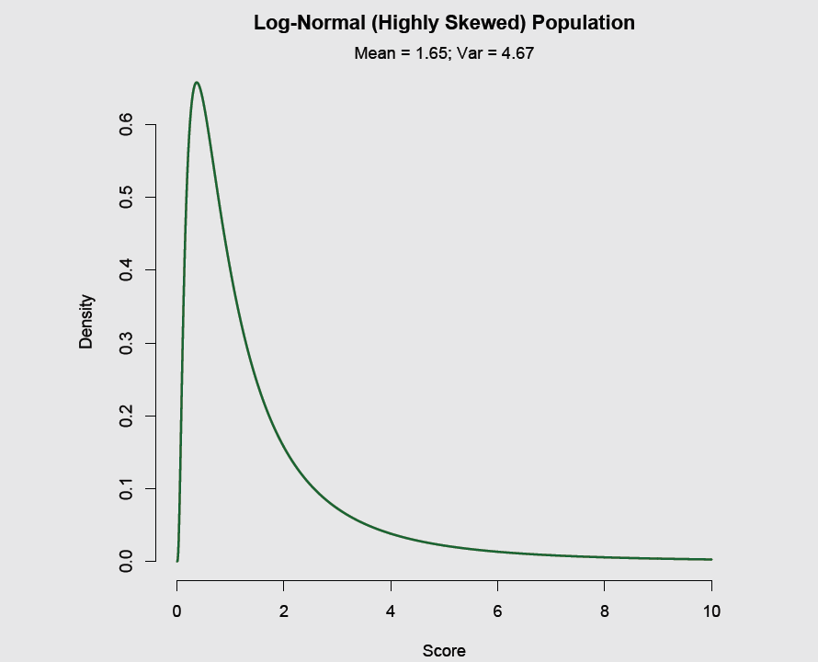
Suppose we have a skewed population distribution

Slide 19
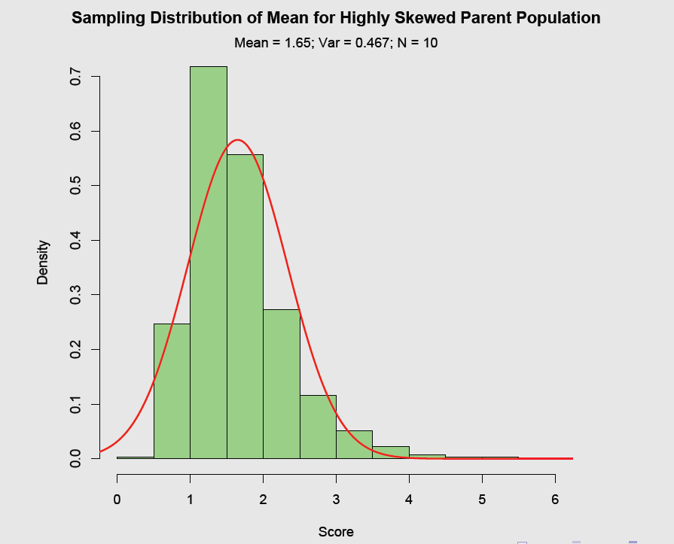
Sampling distribution of mean: n=10

Slide 20
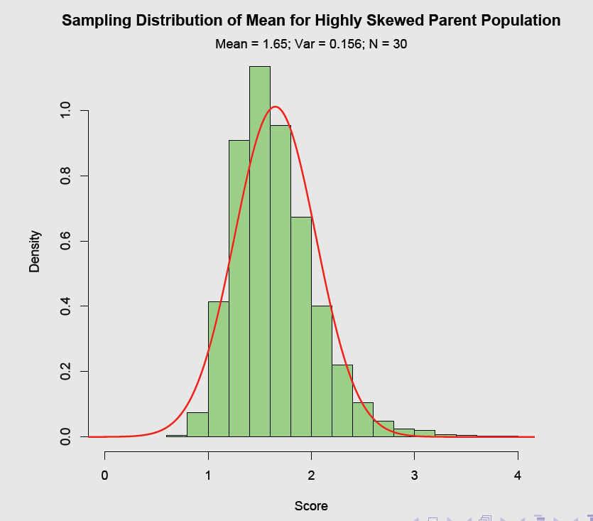
Sampling distribution of mean: n=30

Slide 21
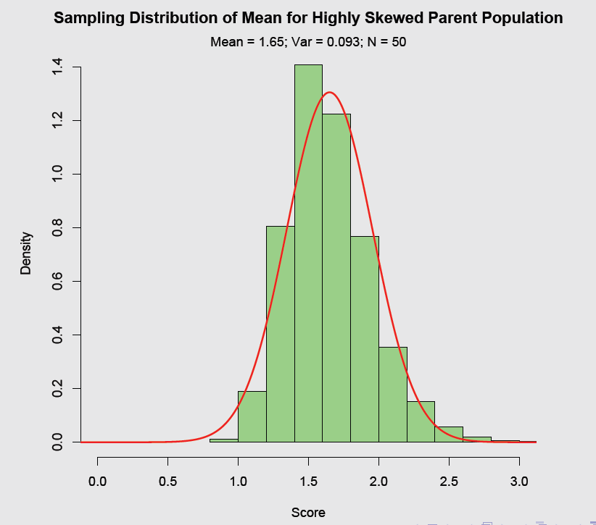
Sampling distribution of mean: n=50

Slide 22
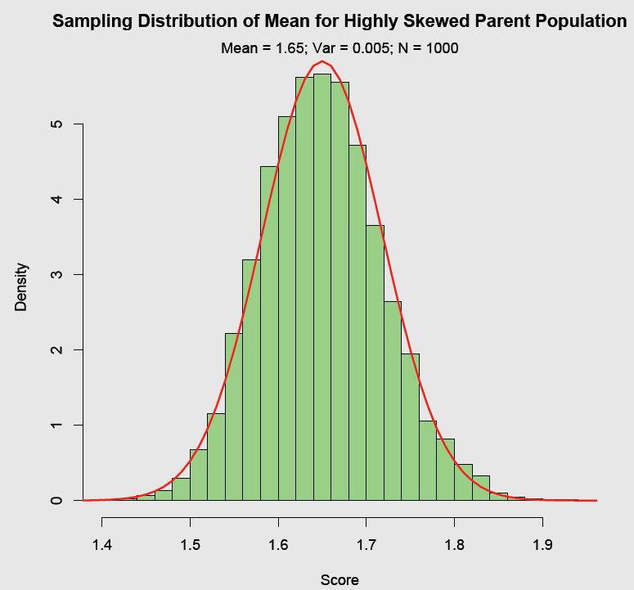
Sampling distribution of log-normal: n=1000

Slide 23
Central Limit Theorem: Take home message
If a variable is normally distributed, the sampling distribution of the mean is also normally distributed (regardless of sample size).
The original distribution affects the shape of the sampling distribution of the mean
Less normal population → less normal sampling distribution of the mean
In psychology, we will rely on the CLT for sampling distributions of the mean when figuring out sampling error.

Slide 24
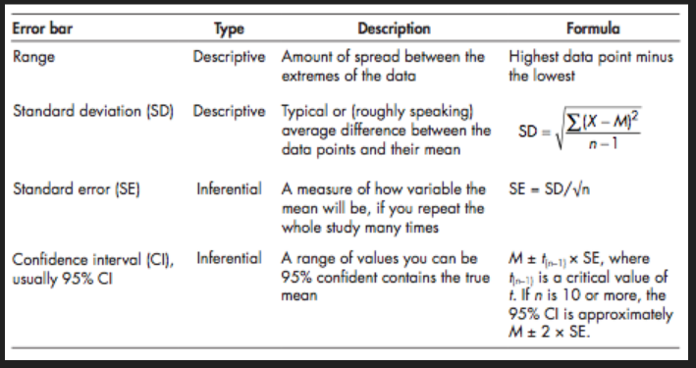
Standard deviation vs. standard error

Slide 25
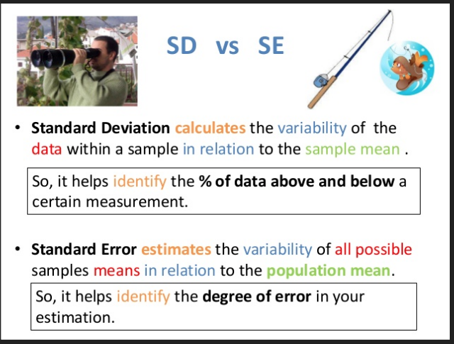
Standard deviation vs. standard error

Slide 26
Using the Sampling Distribution of the Mean
Assumptions about the data (normal distribution) or large enough samples (according to CLT) insure the distribution of the sample mean follows a normal distribution.
Find the probabilities of Means:
We want to know, what is the probability of observing a certain range of sample means?
We do this by transforming raw scores into Z scores and then using a table to look up areas under the normal curve

Slide 27
Example
IQ scores are normally distributed with a (population) mean of 100 and a (population) standard deviation of 15. What is the sampling distribution of the mean for a sample size of 25?

Slide 28
Example
IQ scores are normally distributed with a (population) mean of 100 and a (population) standard deviation of 15. What is the sampling distribution of the mean for a sample size of 25?
Solution:
First, because IQ scores are normally distributed, so the sampling distribution of the mean will be normally distributed

Slide 29
The mean of the sampling distribution of the mean will be equal to
The standard error of the sampling distribution of the mean is equal to

Slide 30
Example
1. What’s the probability of obtaining a sample of 25 IQ scores with a mean of 106 or higher? Suppose the mean and standard deviation of IQ scores are 100 and 15.
Now use the z-table to read the area beyond 2
i.e., P(≥106) = P (Z ≥ 2) = .0228
> 1-pnorm(2)
[1] 0.02275013

Slide 31
Exercise
2. We have a population of scores with μ_{X} = 60 and σ_{X} = 24. Assume the sample size is n = 36.
a. What is (the mean of the sampling distribution of the mean)? What is the standard error of the sample mean?

Slide 32

Exercise
2. We have a population of scores with μ_{X} = 60 and σ_{X} = 24. Assume the sample size is n = 36.
a. What is (the mean of the sampling distribution of the mean)? What is the standard error of the sample mean?

Slide 33
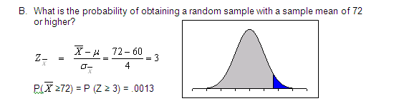
Example
> 1-pnorm(3)
[1] 0.001349898

Slide 34
Example
c. What is the probability of obtaining a sample mean that differs from the population mean by 10 points or more? (Note: could be 10 or more points higher than μ or 10 or more points lower than μ)

Slide 35

Example
c. What is the probability of obtaining a sample mean that differs from the population mean by 10 points or more? (Note: could be 10 or more points higher than μ or 10 or more points lower than μ)

Slide 36
Example
d. For what sample mean value is the probability 1% of obtaining that sample mean or a higher sample mean?

Slide 37

Example
d. For what sample mean value is the probability 1% of obtaining that sample mean or a higher sample mean?
> qnorm(0.01)
[1] -2.326348

Slide 38
Example
e. Within what sample mean values do the middle 95% of the sample means fall?

Slide 39
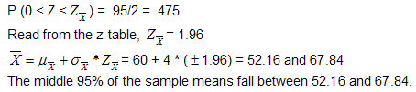
Example
e. Within what sample mean values do the middle 95% of the sample means fall?
> qnorm(1-(1-0.95)/2)
[1] 1.959964

Slide 40
Exercise
A population has a mean (μ) of 24.12, and standard deviation (σ) of 4. Assume that a sampling distribution of sample means has been constructed, based on repeated samples of n=100 from this population.
What would be the value of the mean of the sampling distribution?
What would be the value of the standard error of the mean?

Slide 41
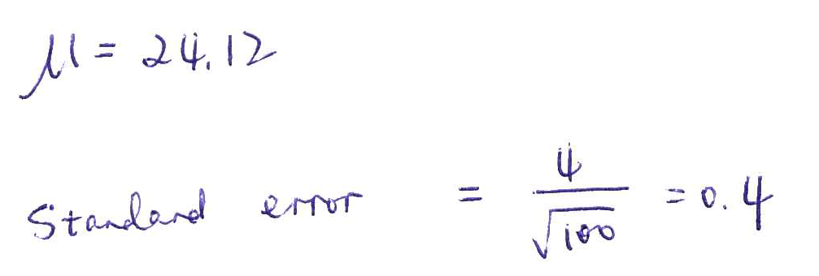
Answer

Slide 42
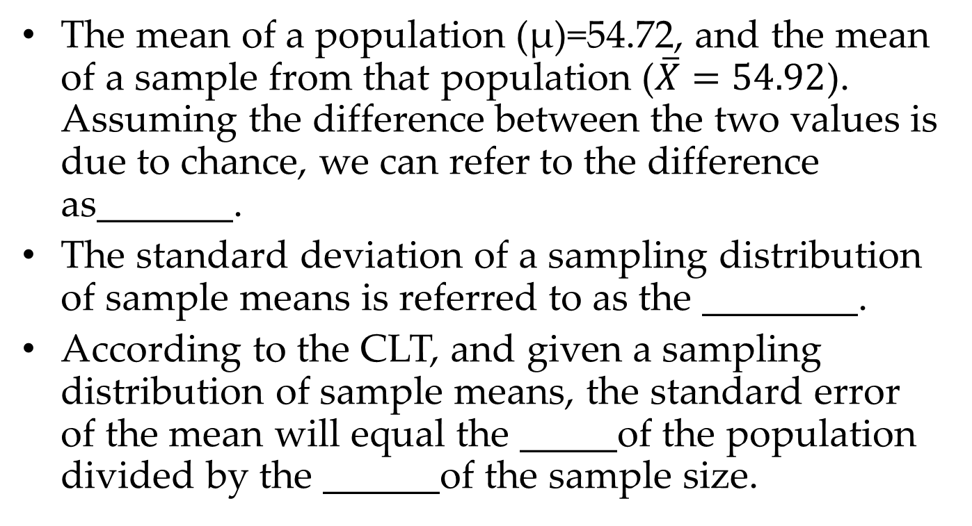
Learning check
The mean of a population (μ)=54.72, and the mean of a sample from that population ($\overline{X}=54.92$). Assuming the difference between the two values is due to chance, we can refer to the difference as_______.
The standard deviation of a sampling distribution of sample means is referred to as the ________.
According to the CLT, and given a sampling distribution of sample means, the standard error of the mean will equal the _____of the population divided by the ______of the sample size.

Slide 43
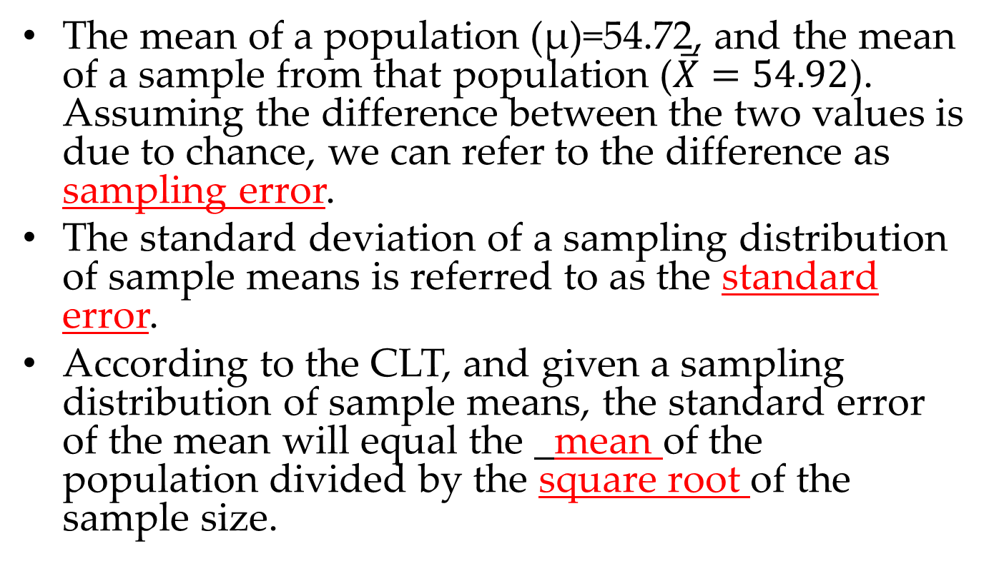
Learning check
The mean of a population (μ)=54.72, and the mean of a sample from that population ($\overline{X}=54.92$). Assuming the difference between the two values is due to chance, we can refer to the difference as sampling error.
The standard deviation of a sampling distribution of sample means is referred to as the standard error.
According to the CLT, and given a sampling distribution of sample means, the standard error of the mean will equal the _mean of the population divided by the square root of the sample size.

Slide 44
Example 1
Suppose you have a set of scores that are normally distributed with μ = 200 and σ = 40.
(a) What proportion of scores is greater than a raw score of 250?
(b) If you randomly select one score from the distribution, what is the probability that the score is greater than 250?
(c) If you randomly select one score from the distribution, what is the probability that the score is NOT between 150 and 190?

Slide 45
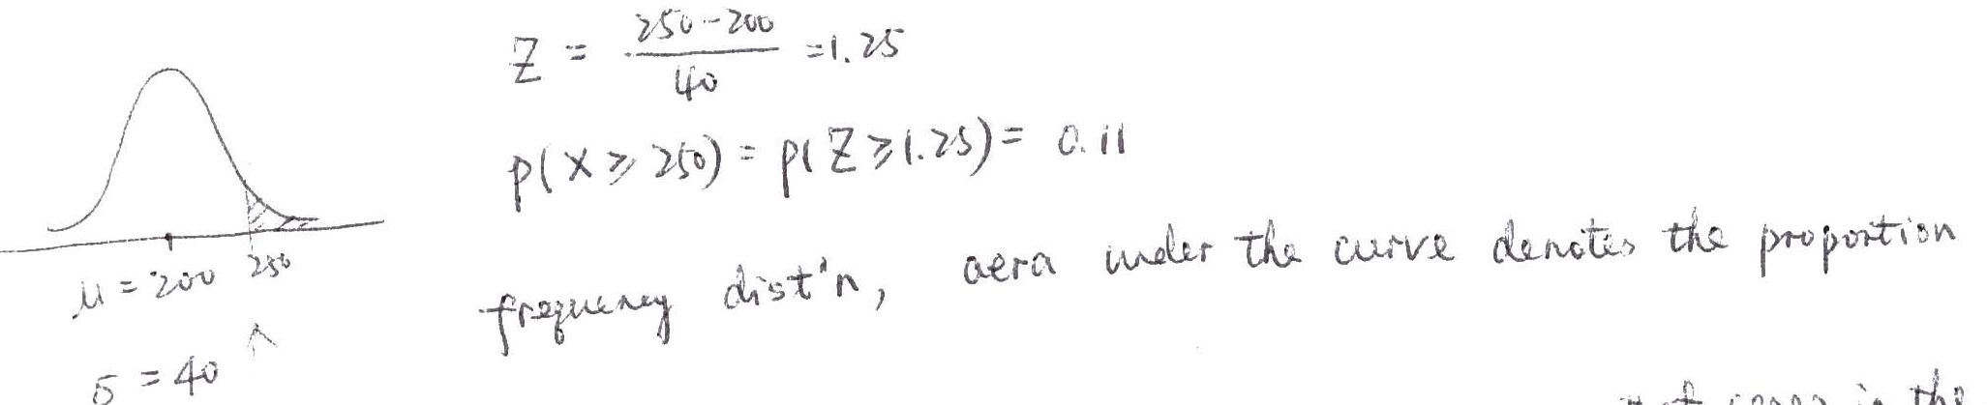
(a) 0.11
(b) 0.11

Slide 46
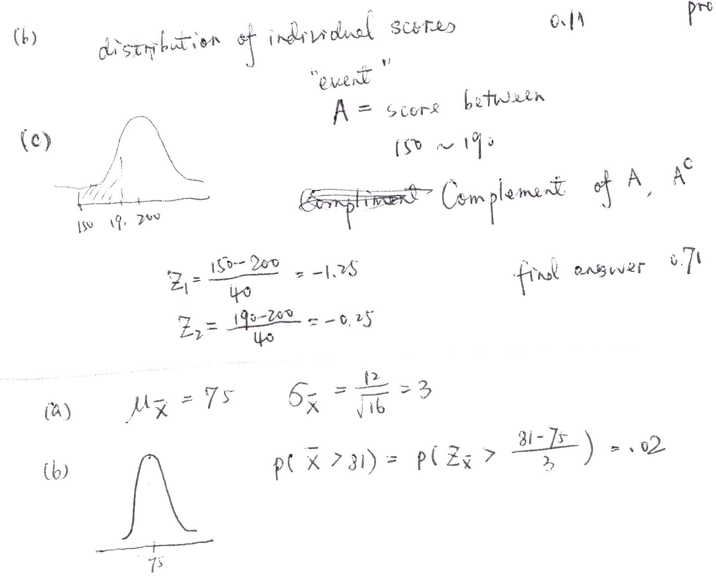

Slide 47
Example 1
Suppose you have a set of scores that are normally distributed with μ = 200 and σ = 40.
(a) What proportion of scores is greater than a raw score of 250?
(b) If you randomly select one score from the distribution, what is the probability that the score is greater than 250?
> 1-pnorm(250,mean=200, sd=40)
[1] 0.1056498

Slide 48
Example 1
Suppose you have a set of scores that are normally distributed with μ = 200 and σ = 40.
(c) If you randomly select one score from the distribution, what is the probability that the score is NOT between 150 and 190?
> 1-(pnorm(190,mean=200, sd=40)-pnorm(150,mean=200, sd=40))
[1] 0.7043561

Slide 49
Example 2
Suppose all of the third graders at Wilson Elementary School take a math test. The scores are normally distributed with μ = 75 and σ = 12.
(a) For the distribution of math test scores, what is the mean and standard error of the sampling distribution of the mean for samples of size 16?
(b) Suppose a sample of 16 third graders is selected from Wilson Elementary School. What is the probability that the mean math test score for the sample is greater than 81?

Slide 50
Example 2
Suppose all of the third graders at Wilson Elementary School take a math test. The scores are normally distributed with μ = 75 and σ = 12.
(a) For the distribution of math test scores, what is the mean and standard error of the sampling distribution of the mean for samples of size 16?
> se=12/(sqrt(16))
>
> se
[1] 3

Slide 51
Example 2
Suppose all of the third graders at Wilson Elementary School take a math test. The scores are normally distributed with μ = 75 and σ = 12.
(b) Suppose a sample of 16 third graders is selected from Wilson Elementary School. What is the probability that the mean math test score for the sample is greater than 81?
> 1-pnorm(81,mean=75, sd=12)
[1] 0.3085375

Slide 52
Summary
Sampling distribution
Mean, standard error, and shape
Central limit theorem
Z-score & probability

